Slide 1
To Include Caste as a Protected Category in Non-discrimination Policy
xxxxxx

Slide 2
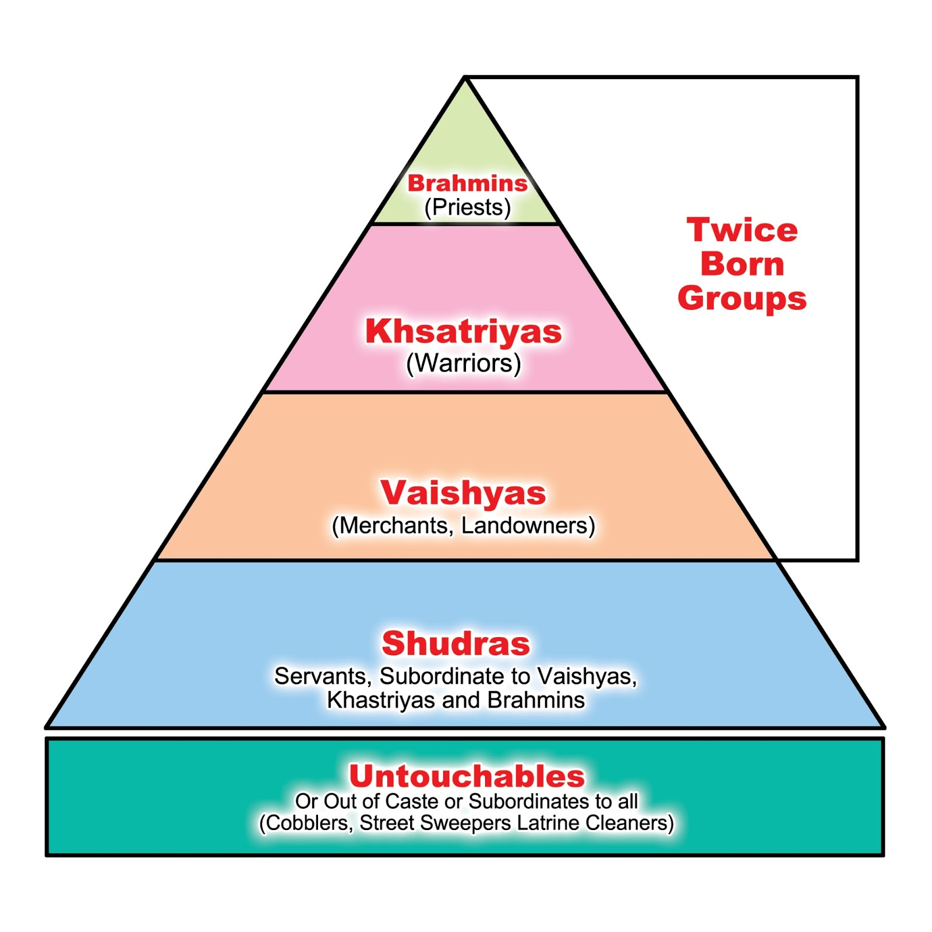
What is Caste?
Dominant Castes
The caste system is a social hierarchical structure of rigid social stratification characterized by hereditary status (with birth), endogamy, and social restrictions sanctioned by customs, traditions and socioreligious beliefs.
The system is supported by the Hindu scriptures and has been existing for more than two thousand years in Indian subcontinent (India, Pakistan, Nepal, Bangladesh and Srilanka).
DALITS
Notes:
Caste is a fundamental social identity which is grounded in the caste system; as you see can in the picture, the caste system is a social hierarchical order or structure of social stratification characterized by hereditary status (by birth), strict endogamy and social barriers sanctioned by customs, traditions and numerous beliefs.
Here I am presenting simplistic views of the caste system and caste identities. Caste is not like class, caste identity is a fixed position in the system.
In the picture, you can see the first three castes are known as the dominant castes or so-called upper castes, the fourth in blue color is intermediary castes and known as so called lower castes and last, Dalits are out caste from the Hindu social order; Dalits are stigmatized groups and formerly they were known as untouchables, means touching is polluting. Caste-based discrimination and untouchability mainly affects Dalits.
Caste-based hierarchies exist throughout South Asia, but are most rampant in India. So, for this presentation, I have used references from India only.

Slide 3
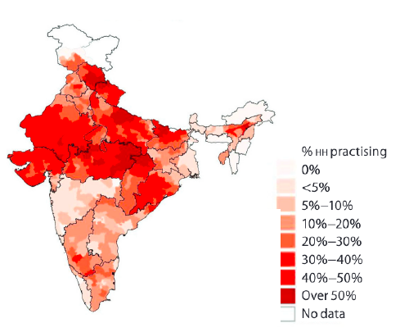
Caste Discrimination in India
Untouchability and caste-based discrimination is pervasive in rural and urban areas (Jodhka, 2016).
Around 5 million manual scavengers are employed by public authorities and one person dies every 5 days (India’s National Commission for Safai Karamcharis 2017-18).
Caste Atrocities: every 15 minutes a crime is committed against a Dalit and every day, 6 Dalit women are raped (India’s National Crime Reports Bureau data, 2019).
A Dalit police officer asked for police protection to ride on horse in his marriage procession (The Times of India, 2019, May 11).
Notes:
In the picture, we can see how caste discrimination is pervasive in India. In rural areas, caste-based discrimination is overt and normalized, but in cities, it is covert and subtle. Casteism is institutionalized, similar to racism in US, and it is a systemic problem in India.
In India, a large number of Dalits are working in menial or low-status jobs; around 5 million manual scavengers, most work in dangerous conditions without protective gear, they are employed by public authorities and one person dies every 5 days.
Despite the fact, caste-based discrimination is a criminal offence by laws, caste atrocities are being used as a tool to maintain hegemony of the dominant castes, similar like lynching in US in the past. For example, every 15 minutes a crime is committed against a Dalit and every day, 6 Dalit women are raped.
Let me give you an example of caste culture, in 2019, a Dalit police officer asked for police protection to ride on horse in his marriage procession because the dominant castes of his village warned him, “not to ride on horse”. As per a caste norm, Dalits shouldn't ride on horse, if they do, will face consequences, like caste atrocity and social ostracism.

Slide 4
Caste in United States
More than 90 percent of Indian immigrants belong to the dominant castes and merely 1.5 percent associated with Dalit communities (Center for the Advanced Study of India, 2003).
The first caste-based discrimination lawsuit in the US was filed in 2020 by the California Department of Fair Employment and Housing against Cisco Systems (Dutt, 2020, July 14).
Violations of labour laws at a temple construction, by Dalit labors, site in the city of Robbinsville, NJ (Mogul, 2021, June 03).
67 percent of so-called lower-caste respondents said they had suffered caste discrimination in the workplace (Equality Labs, 2018).
41 percent of lower-caste respondents reported that they faced caste discrimination in U.S. schools and universities (Equality Labs, 2018).
Notes:
It is a well-known fact that South Asians and especially, Indians are one of the biggest immigrant groups in US, and they bring their culture, socioreligious values and caste prejudices. As Isabel Wilkerson says, caste is the bones and race the skin. Now let’s see how caste manifest in the US.
According to the center for the Advanced Study on India, at UPenn, more than 90 percent of Indian immigrants belong to the dominant castes and only 1.5 percent belong to Dalits.
In 2020, the first caste-based discrimination lawsuit in the US was registered by CA Department of FHE against Cisco Systems, which is pending in the Supreme Court of CA.
In 2021, a local authority in New Jersey filed a legal complaint for violations of labour laws at a temple construction site where many Dalit labors from India were kept as slaves, they were paid less than a dollar per hour.
According to the first large-scale study on caste-based discrimination in US by Equality Labs, a non-profit, 67 percent of so-called lower-caste participants said they had suffered caste discrimination in the workplace and 41 percent of lower-caste participants reported that they faced caste discrimination in schools and universities. It indicates that caste-based discrimination happens in higher education institutions, but we don’t recognize it.

Slide 5
Why should we support the proposal ?
To show solidarity with the MSP to defend the rights of caste-oppressed people at the campus
To recognize caste-based discrimination to protect caste oppressed people at the campus
It will empower caste oppressed people to raise their voice against caste bigotry
To set a precedent as the first public university on the east coast to add caste in its non-discrimination policy.
As a student community, we should set an example for the UMass administration to follow.
Notes:
We should support the proposal to making caste a protected category in the non-discrimination policy because
To show solidarity with the MSP to safeguarding the rights of caste-oppressed people at the campus which is mentioned in the support letter.
To stop caste-based discrimination and to protect caste oppressed people at the campus.
Caste as a protected category will empower caste oppressed people to raise their voice against caste bigotry.
To set a precedent as the first public university on the east coast to add caste to their non-discrimination policy. So far California State University, UC Davis, Brandies, Colby college, Harvard have added caste as a protected category in other forms, such as student contracts, collective bargaining agreements, DEI policies, etc..
As a student community, we should set an example for the UMass administration to follow. Caste as a protected category will not harm or marginalize any group, similar like race and gender categories, it will protect caste oppressed people from caste-based discrimination.

Slide 6


